Slide 1



Uptake of PrEP within family planning clinics: Results from a large implementation program in Kenya
K. Mugwanya¹, J. Pintye¹, J. Kinuthia^{1,2}, F. Abuna³, H. Lagat³, M. Serede³, J. Sila³, G. John-Stewart⁴, J. Baeten⁴
PrEP Implementation for Young Women and Adolescents (PrIYA) Program
¹ University of Washington, Seattle, United States; ² Kenyatta National Hospital, Nairobi, Kenya; ³University of Washington-Kenya, Nairobi, Kenya
PrIYA is funded through the DREAMS Innovation Challenge.
Disclaimer: This presentation was funded by a grant from the United States Department of State as part of the DREAMS Innovation Challenge, managed by JSI Research & Training Institute, Inc. (JSI). The opinions, findings, and conclusions stated herein are those of the authors and do not necessarily reflect those of the United States Department of State or JSI.
Notes:
Good afternoon. On behalf of my co-authors, I am pleased to present this abstract about PrEP uptake in an implementation program within routine family planning clinics in Kenya.

Slide 2
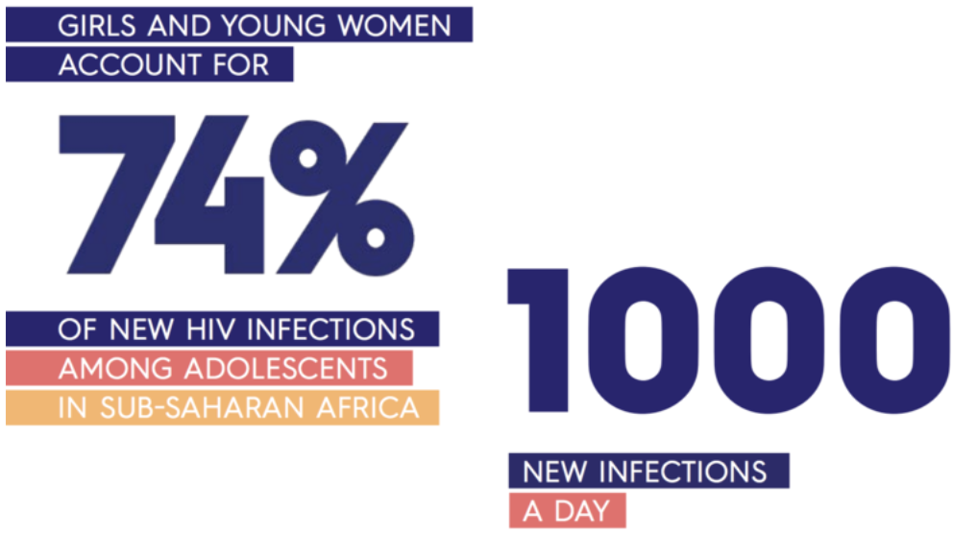
UNAIDS 2016
Notes:
There is an urgent need to prevent HIV in adolescent girls and young women. Within sub-Saharan Africa, girls and young women account for 74% of new HIV infections among adolescents and this group has a 2- to 8-fold higher risk of HIV compared to males of the same age. 1000 new HIV infections occur among young African women each day. As HIV prevention programs targeting young women scale up in the region, routine care settings frequently accessed by young women could be leveraged as a platform for reaching this important high-risk group.

Slide 3
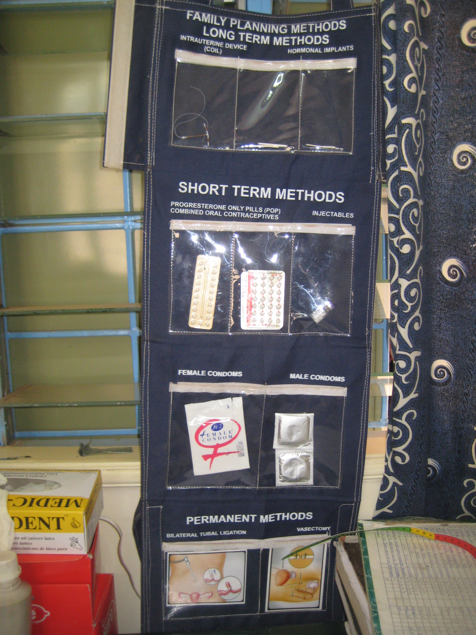
Opportunities for PrEP within family planning (FP) clinics
FP providers are uniquely skilled to offer reproductive health options
FP clinics reach women who are sexually active with potential HIV risk
FP clinics have systems in place for drug delivery and registers to track clients
WHO recommends integrated FP/HIV care
Seidman et al 2018; Seidman et al 2016; Garfinkel et al 2017; Cohen et al 2017
Notes:
Routine family planning clinics are a particularly attractive option for integrated PrEP delivery for several reasons. Family planning providers are uniquely positioned to counsel on and provide PrEP as they already counsel on sexual health, relationship climate, and other sensitive topics as part of existing reproductive health services.
(CLICK) Sexually active women access family planning clinics and are routinely screened for sexual behavior including HIV risk factors. PrEP screening could be integrated efficiently within this context to identify women with HIV risk.
(CLICK) Family planning clinics also have systems for drug procurement, commodity management, and tracking patients which could be leveraged for PrEP.
(CLICK) Further, the World Health Organization and several ministries of health recommend integrating FP and HIV services to increase access to both, including provision of HIV testing and HIV prevention services in FP clinics.

Slide 4
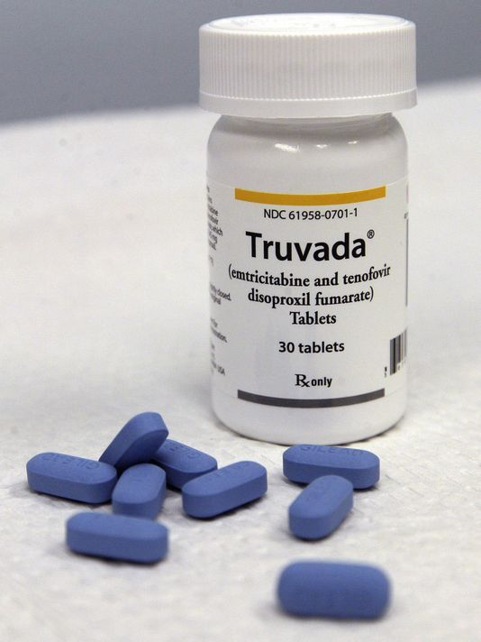
Unanswered questions about PrEP delivery in routine FP settings
Do FP clients recognize risk for HIV?
Will FP clients want PrEP?
How do preferences for HIV and pregnancy prevention differ?
Will PrEP use and adherence differ by contraceptive type used?
Notes:
However, to date, there are few examples of integrated PrEP delivery within family planning clinics in African settings. This leaves a number of key implementation science gaps. For example, will women recognize their HIV risk and accept PrEP when offered within the context of routine FP care? Will preferences for methods of pregnancy and HIV prevention differ in this group? Will there be differences in PrEP use among women using different forms of contraception? Answering these questions will be important for optimizing PrEP in this setting.

Slide 5
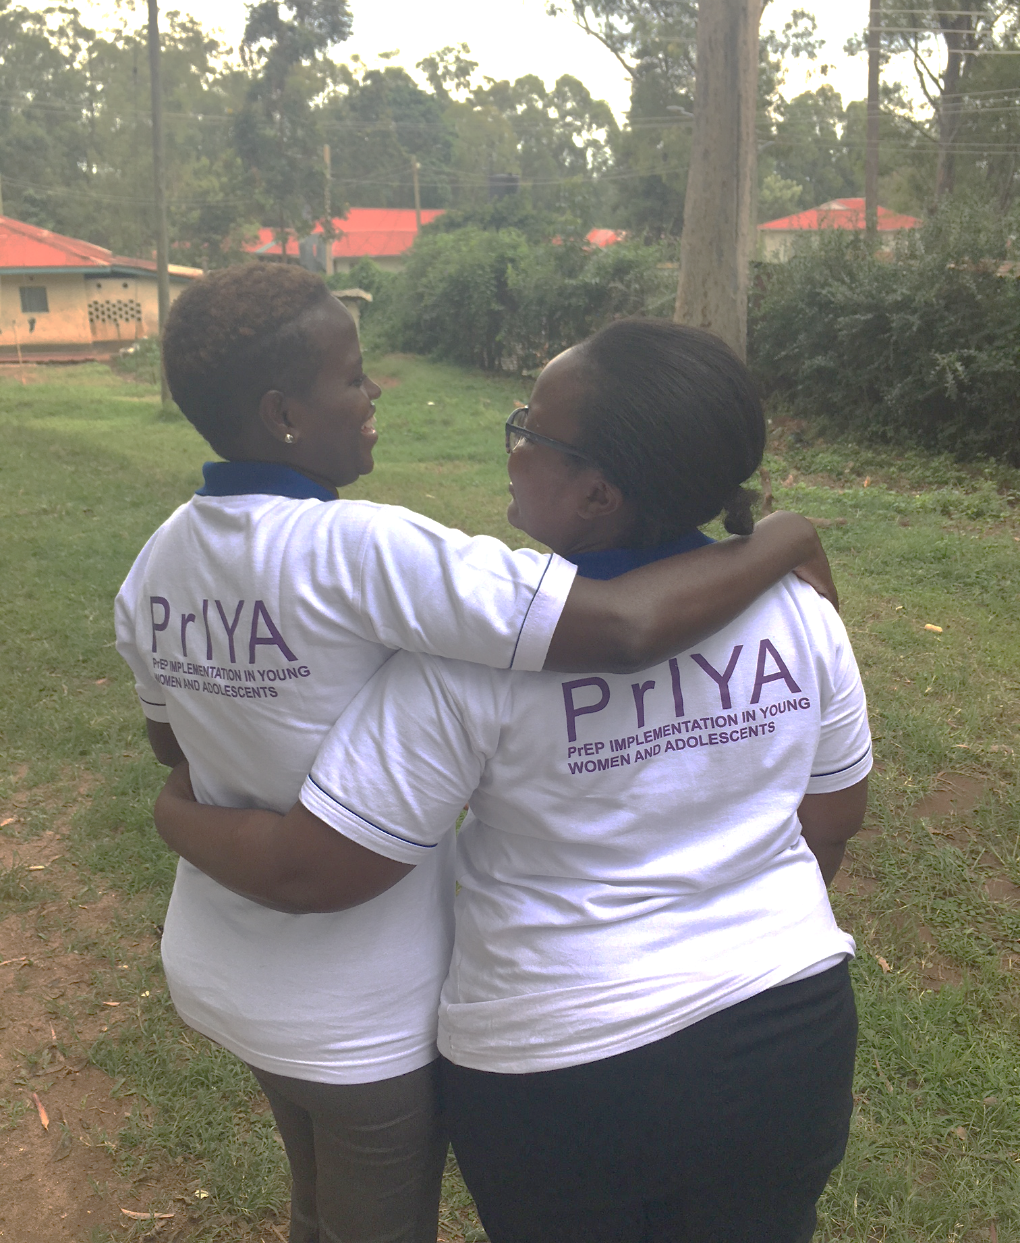
Implementation program delivering PrEP within MCH and FP clinics in Kisumu, Kenya.
PrIYA is part of the DREAMS Innovation Challenge funded by PEPFAR &
managed by JSI Research & Training Institute, Inc.
Notes:
We sought to address some of these implementation science gaps through the PrEP Implementation for Young Women and Adolescents (known as PrIYA) Program. PrIYA is a PrEP implementation program and is part of the DREAMS Innovation Challenge, funded by PEPFAR and managed by JSI. PrIYA provides real-world evidence on delivering PrEP to young women integrated within routine maternal child health and family planning clinics in Kisumu, Kenya. I’ll be presenting findings from PrIYA today.

Slide 6
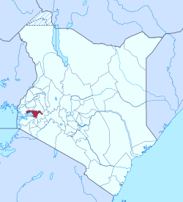
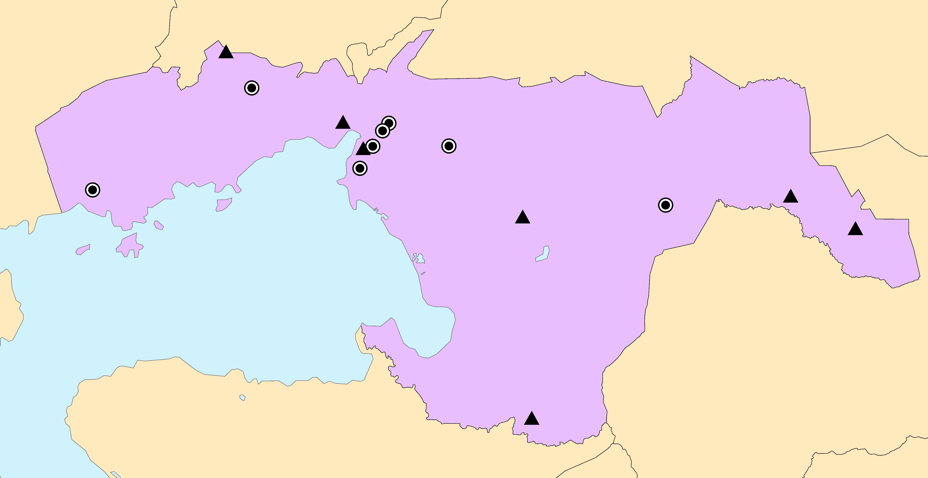
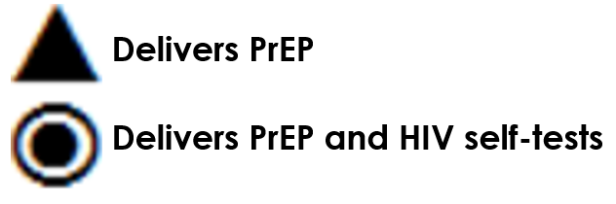
Distribution of 16 PrIYA sites across Kisumu County
Notes:
PrIYA implements integrated PrEP delivery in Kisumu County, which borders Lake Victoria in Western Kenya. PrIYA is implemented in 16 sites across the County.

Slide 7
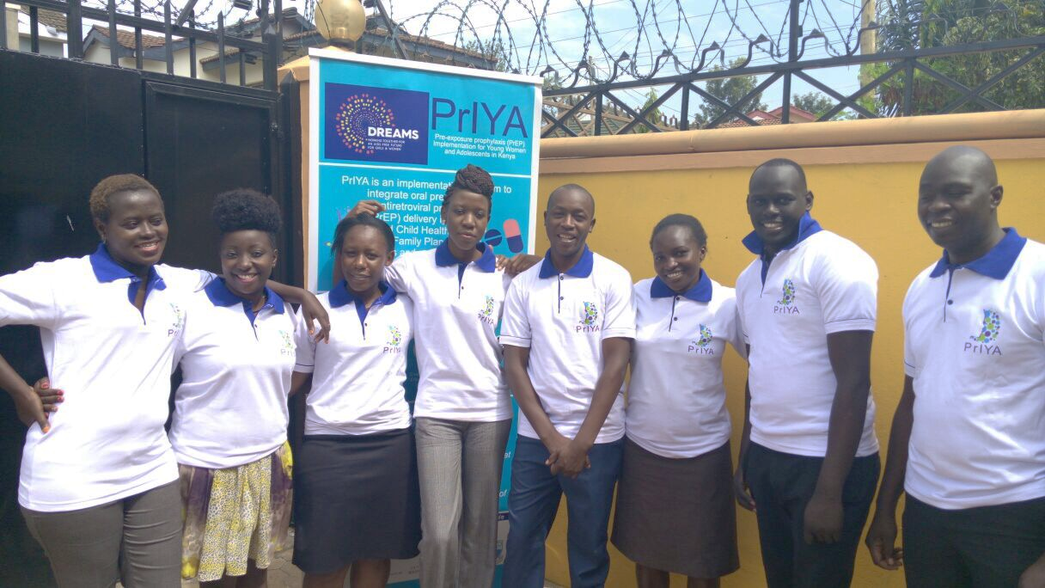
AIM
Evaluate PrEP acceptance and cofactors of uptake among women offered PrEP during routine FP visits
Notes:
And today I will present the results of an analysis which aims to evaluate PrEP acceptance and cofactors of uptake among women offered PrEP during routine visits at family planning clinics.

Slide 8
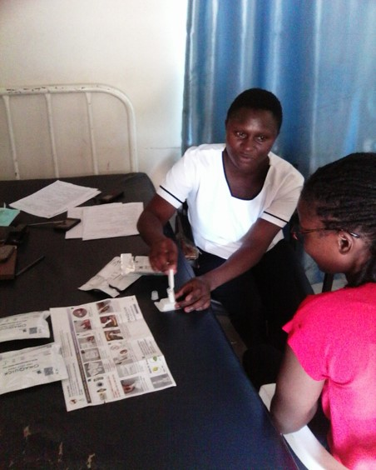
Methods
Integrated PrEP delivery within routine FP clinics
HIV-uninfected women attending routine FP visits
Screened for behavioral risk factors and willingness to consider PrEP
Notes:
We approached HIV-uninfected women seeking routine family planning services at the 16 PrIYA sites in Kisumu County. Women were tested for HIV prior to family planning services as part of routine care. Following receipt of HIV testing and family planning services, HIV-uninfected women were individually screened for behavioral risk factors and willingness to consider PrEP per national PrEP guidelines which includes conducting a behavioral risk assessment.

Slide 9
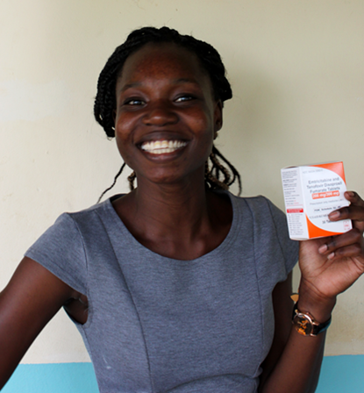
Methods (cont’d)
Dispensed PrEP at the same visit to those willing to initiate and medically eligible
Logistic regression models to determine cofactors of uptake
Data from Nov 2017-June 2018
Notes:
Those who were willing to consider PrEP were assessed for medical eligibility. Those eligible were dispensed PrEP at the same visit by the same nurse within the family planning clinic – no additional pharmacy pick-up was required. To determine correlates of PrEP initiation we used Logistic regression models accounting for facility-level clustering. The current analysis includes data from November 2017 thorough June 2018.

Slide 10
Results
Women assessed for behavioral risks & willingness to consider PrEP during routine FP clinic visits
N=1122
Did Not Initiate PrEP
N=890 (79%)
Initiated PrEP
N=232 (21%)
Notes:
(CLICK) In total, 1,122 women attending FP visits were screened for behavioral risk factors and willingness to consider PrEP. (CLICK) Of whom, 21% initiated PrEP.

Slide 11
Characteristics of women offered PrEP (n=1122)
Median (IQR) or %
Age (years) | 25 (22-29)
Age <24 years | 42%
Married | 83%
Partner HIV status
HIV-uninfected | 62%
HIV-infected | 4%
Unknown | 34%
Notes:
The median age of women was 25 years and most were married. One-third of women reported having a partner of unknown HIV status and 4% had an HIV-infected partner.

Slide 12
FP methods used by women offered PrEP (n=1122)
IUD=Intrauterine device
OCP=oral contraceptive pills
Notes:
Over half of women used injectable contraception methods and nearly one-third of women used implants. Less than 5% of women used each respective other FP method, including oral contraceptive pills

Slide 13
PrEP uptake by characteristics (n=1122)
Partner HIV status
(p<0.001)
Age
(p<0.001)
Marital status
(p=0.007)
Notes:
To answer who would initiate PrEP if offered, we evaluated PrEP uptake by a number of key characteristics. Overall, 21% of all women who were screened initiated PrEP. (CLICK) Frequency of PrEP initiation differed by male partner HIV status with almost all women with HIV-infected partners initiating PrEP. About 1/3 of women who had partners of unknown HIV status initiated PrEP. (CLICK) PrEP initiation was more frequent among women older than 24 years than younger women. (CLICK) and among unmarried women.

Slide 14
PrEP uptake by FP method (n=1122)
Notes:
To answer whether uptake of PrEP differs by contraceptive method used, we stratified frequency of PrEP uptake by type of FP method. (CLICK) Frequency of PrEP uptake was lowest among injectable contraceptive users at 17%. However, injectable users were there largest group of women offered PrEP, comprising over half of the overall population. Therefore in absolute numbers, injectable users were the largest group of PrEP initiators. (CLICK) Frequency of PrEP uptake was highest among oral contraceptive pill users at 30%, though few women used pills as a contraceptive method. Uptake was similar among implant users. (CLICK) PrEP uptake was similar across other methods, though frequency of these methods was very small.

Slide 15
Correlates of PrEP initiation (n=1122)
Crude Odds Ratio (95% CI)
Diagnosed with STI¹ | 10.6 (4.1-27.1)**
Forced to have sex¹ | 6.6 (2.2-20.3)*
Experienced IPV¹ | 4.8 (2.3-10.1)**
Partner HIV status unknown | 3.5 (2.1-5.6)*
Age ≥24 years | 1.9 (1.3-2.6)**
Condom use | 1.4 (0.9-2.0)
OCP use (vs injectables/LARC)² | 1.8 (1.0-3.2)*
*p<0.05; **p<0.001; ¹ In the last 6 months ; ² Including injectable, implants, and IUDs
Notes:
We also evaluated whether women with HIV risk factors were more likely to initiate PrEP. And here the astericks indicate level of significance. Initiating PrEP was associated with behavioral risk factors such as having been diagnosed with an STI, being forced to have sex, experiencing IPV in the last 6 months, and having a partner of unknown HIV status. (CLICK) Women were also more likely to initiate PrEP if they were older than 24 years. (CLICK) Condom use was not associated with PrEP uptake. (CLICK) women using oral contraceptive pills were nearly 2 times as likely to initiate PrEP as women using long-acting methods of family planning.

Slide 16
Reasons for declining PrEP among women with HIV risk factors (n=380)
Notes:
Among women who had risk factors for HIV but declined PrEP, the most frequently reported reasons for declining were needing to consult partners and low perceived HIV risk. Nearly one-quarter of women reported pill burden as a reason for declining PrEP. Few women declining PrEP feared intimate partner violence as a result and side effects.

Slide 17
Conclusions
Routine FP visit attendees were interested in PrEP
PrEP initiators were more likely to have HIV risk factors
Adolescents less likely to use PrEP than older women
PrEP may be easier to navigate for OCP users
Notes:
In summary, approximately 1/5 of women attending routine FP visits initiated PrEP in this large implementation program. PrEP initiators were more likely to have HIV risk factors than women who declined PrEP. OCP users were more likely to uptake PrEP than women using long-acting methods and pill burden was a frequently reported reason for declining PrEP. These findings are important for guiding new directions for PrEP agents and delivery that respond to the needs of women for whom a daily pill may not be acceptable.

Slide 18
Implications
FP clinics could be key access points for women to obtain PrEP
Need to find ways to support oral PrEP among women using long-acting FP methods
Need to understand barriers for PrEP use in adolescents at FP clinics
Notes:
Our findings support that FP clinics could be important PrEP access points for women in high HIV burden settings and innovations are needed to increase PrEP acceptance in this group, particularly among injectable and LARC users. And also we need additional data to understand barrier to PrEP among adolescents accessing FP clinics.

Slide 19

More PrIYA at
PrEP uptake among pregnant and postpartum women: results from a large implementation program within maternal child health (MCH) clinics in Kenya
J. Kinuthia, J. Pintye, F. Abuna, H. Lagat, K. Mugwanya, J. Dettinger, M. Serede, J. Sila, J.M. Baeten, G. John-Stewart
Session Code: WEAE04
Session Title: PrEP: Work in progress
Session Date: Wednesday, 25 July 2018
Session Time: 14:30-16:00
Session Room: Elicium 1
Notes:
Tomorrow Dr. John Kinuthia will present findings from PrIYA on uptake of PrEP among pregnant and postpartum women within routine maternal-child health clinics and I encourage you to join in that discussion if you are interested in integrated PrEP delivery.

Slide 20

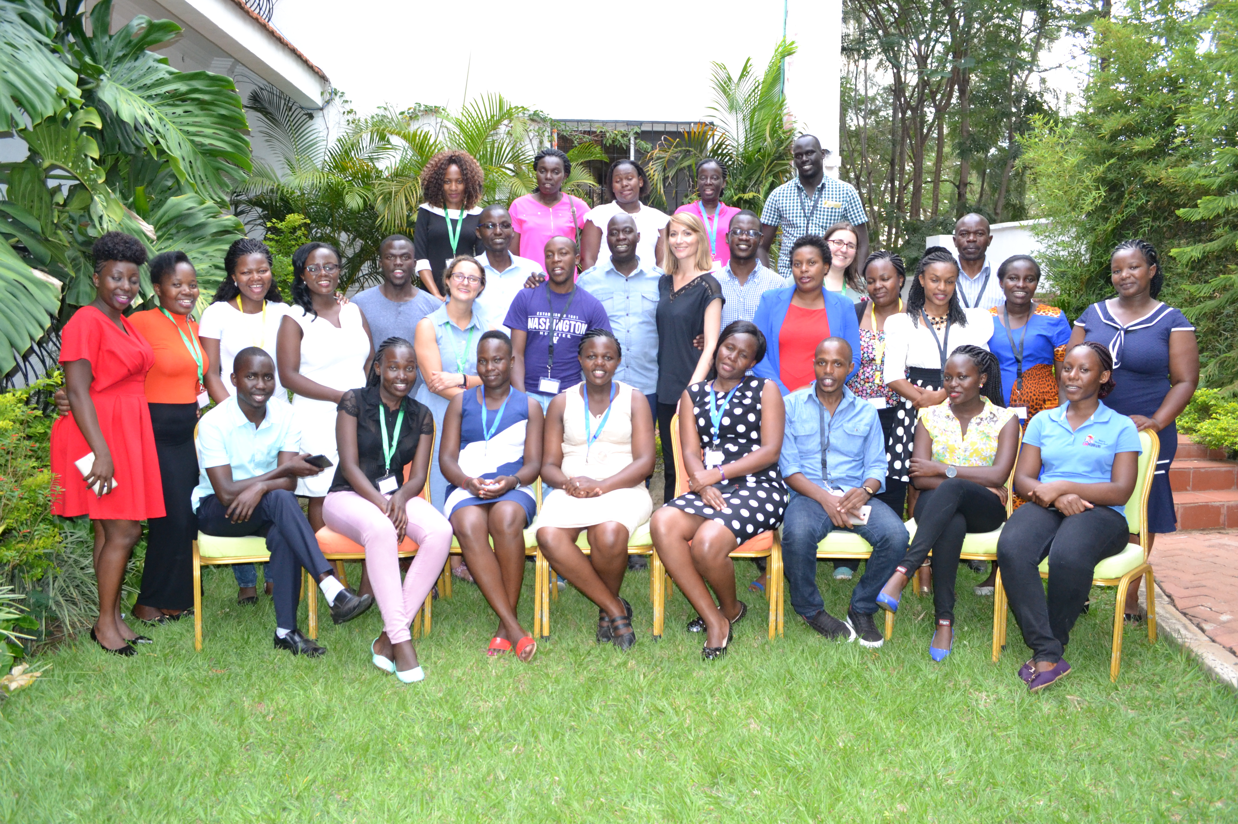





Acknowledgments
We gratefully acknowledge all of the PrIYA Program participants.
PrIYA Program staff, the Kenyan Ministry of Health, and Kisumu County Government.
PrIYA is funded by the United States Department of State as part of the DREAMS Innovation Challenge, managed by JSI Research & Training Institute, Inc.
This presentation was funded by a grant from the United States Department of State as part of the DREAMS Innovation Challenge, managed by JSI Research & Training Institute, Inc. (JSI). The opinions, findings, and conclusions stated herein are those of the authors and do not necessarily reflect
Notes:
We thank all of our participants, staff, and collaborators. And a special thanks to our funder, the DREAMS Innovation Challenge and PEPFAR, and to JSI.

